Slide 1


3rd International Conference on Business Intelligence and Data Analytics (BIDA 2026)
Enhanced Predictive Modeling for Early-Stage Lung Cancer Diagnosis through GenAI
Paper ID - 1368
Presented by :
Ms. P. Dhanalakshmi
Mr.K. Naveen Kumar
P. Jayasree
S.Tulasi Rao
N. Muni Bhargav
N. Sai Jaswanth
Organised by:
RV Institute of Management (RVIM), Bangalore, India
Technically Sponsored by Soft Computing Research Society

Slide 2
Contents :
Abstract
Introduction
Literature Survey
Existing System
Proposed System
Conclusion
References

Slide 3
Abstract
Early detection of lung cancer improves treatment outcomes, but limited and imbalanced datasets reduce prediction accuracy. This study proposes a generative-enhanced framework that integrates Conditional Tabular Generative Adversarial Networks (CTGAN) with tree-based models like Random Forest and Gradient Boosting. CTGAN generates synthetic, class-balanced data, addressing data scarcity and improving model performance. Experiments show higher accuracy, sensitivity, and F1-score compared to conventional methods.

Slide 4
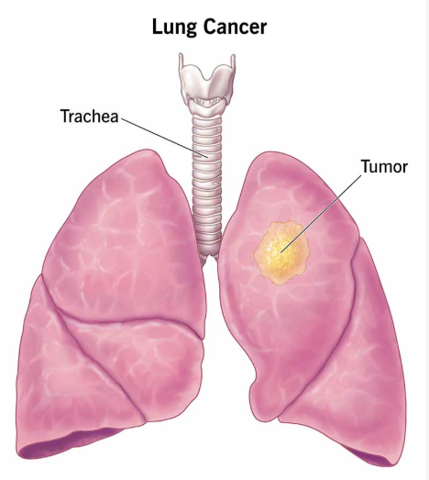
Introduction
Fig-1 : Lung Cancer
Lung cancer is a serious disease in which abnormal cells grow uncontrollably in the lungs. It is one of the leading causes of cancer-related deaths worldwide, mainly because it is often diagnosed at a late stage. Early detection can significantly improve survival and treatment outcomes.

Slide 5
Types of Lung Cancer
Lung Cancer is mainly classified into two major types:
1. Non-Small Cell Lung Cancer (NSCLC) and
2. Small Cell Lung Cancer (SCLC).
In addition, there are rare types like lung carcinoid tumors, which are slow-growing, and other uncommon forms such as sarcomas and lymphomas. Each type varies in its behavior, progression, and treatment approach.

Slide 6
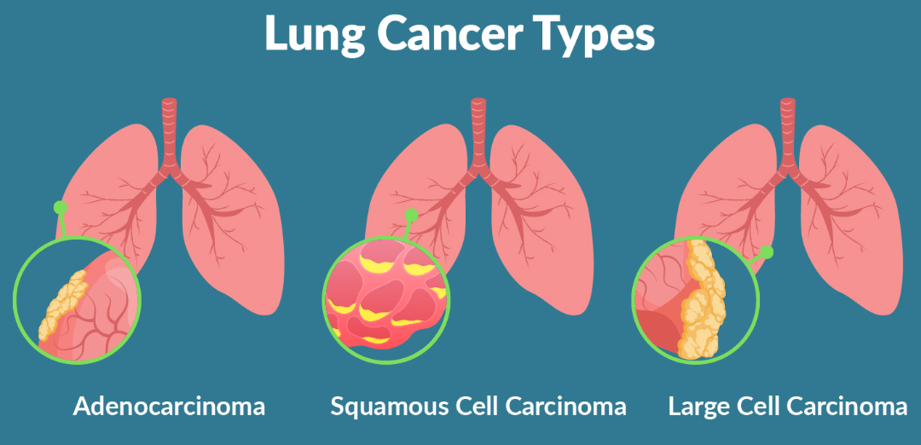
Fig 2 : Types of Lung Cancer

Slide 7
Lung Cancer Symptoms
Long-lasting cough
Chest pain
Blood while coughing
Breathing trouble
Feeling very tired
Weight loss
Loss of appetite
Frequent chest infections

Slide 8
Literature Survey
Year | Author | Title | Implementation | Drawbacks
2022 | Sharma et al. | Hybrid ML–DL Framework for Lung Cancer Prediction | Combined deep learning models with traditional ML algorithms for classification | Complex architecture, high computational resource requirement
2023 | Fatoki et al. | Comparative Analysis of Machine Learning Models for Lung Cancer Detection | Evaluated KNN, Logistic Regression (LR), SVM, and Naïve Bayes (NB) | Small dataset, class imbalance issue
2023 | Wang et al. | Deep Learning Models for Medical Image-Based Lung Cancer Detection | CNN and RNN architectures for feature extraction and classification from medical images | Requires large dataset, low interpretability
2024 | Bhuiyan et al. | Ensemble Machine Learning Approaches for Lung Cancer Diagnosis | Implemented LR, XGBoost, SVM, LightGBM, and AdaBoost | Biased prediction due to class imbalance
2024 | Kumar et al. | Explainable AI-Based Tissue Image Classification Model | Applied explainable deep learning techniques for tissue image detection | High computational complexity
2025 | Alzahrani et al. | CTGAN-Based Synthetic Data Generation for Lung Cancer Classification | Used CTGAN for data augmentation with Random Forest classifier | Limited real-world validation

Slide 9
Existing System
Existing systems for Lung Cancer detection use imaging techniques like CT scans and X-rays along with biopsy methods for confirmation. Computer-Aided Diagnosis (CAD) helps analyze medical images, while Machine Learning and Deep Learning models automatically classify and predict cancer. These approaches improve early detection and assist doctors in decision-making.

Slide 10
Problem Identification
Early detection of Lung Cancer is difficult due to limited, imbalanced, and low-quality medical datasets. Traditional machine learning models struggle with class imbalance, leading to inaccurate predictions, especially false negatives. Existing approaches also fail to capture complex relationships in clinical data and often lack reliability and real-world applicability. Additionally, deep learning methods require large datasets and high computational resources, making them less practical in many healthcare settings.

Slide 11
Objective
To improve early-stage lung cancer prediction accuracy
To handle data imbalance using synthetic data generation (CTGAN)
To develop a robust predictive model using ensemble techniques
To enhance model interpretability for better clinical understanding
To reduce false negatives and improve diagnostic reliability

Slide 12
Scope of the Work
This work focuses on developing an AI-based predictive system for early detection of lung cancer using clinical tabular data. It integrates data preprocessing, synthetic data generation, and ensemble learning models to improve prediction performance. The system is designed to assist clinicians by providing accurate risk predictions along with interpretable insights. It can be extended to real-time clinical applications and further enhanced by integrating imaging data and advanced deep learning techniques in future.

Slide 13
Proposed Architecture
The proposed framework leverages Conditional Tabular Generative Adversarial Networks (CTGAN) to generate high-quality synthetic clinical data, effectively addressing the issue of class imbalance in lung cancer datasets. By producing realistic cancer and non-cancer samples, the model enhances dataset diversity while preserving complex relationships between clinical and demographic features.
The enhanced dataset is then utilized by tree-based machine learning models, including Random Forest and ensemble techniques, to perform accurate classification. By integrating generative modeling with predictive analytics, the system improves generalization, reduces overfitting, and delivers more stable performance.

Slide 14
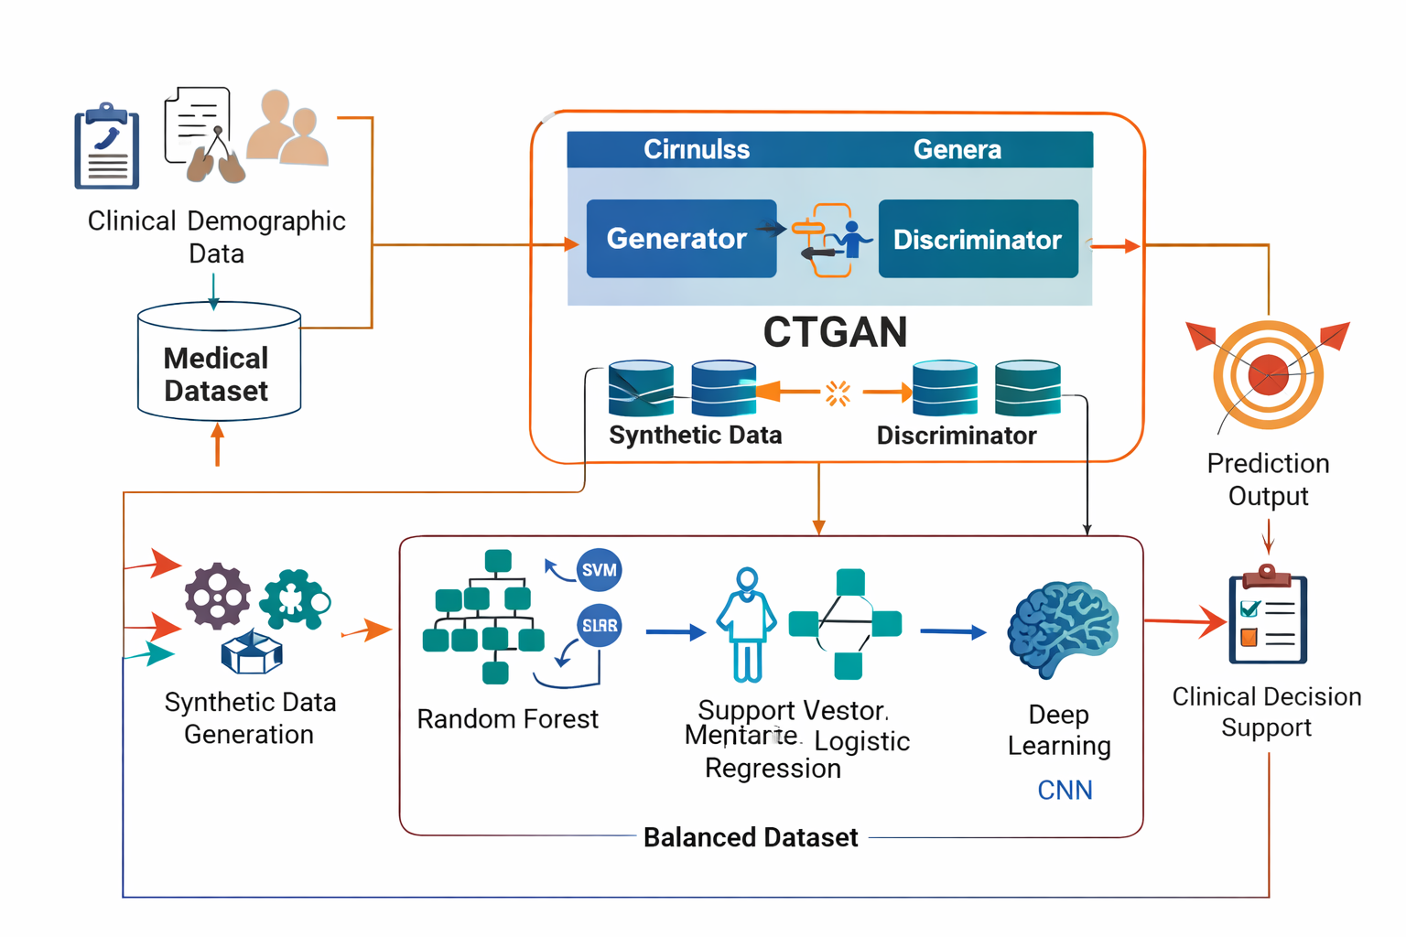
Architecture of Lung Cancer Diagnosis
Fig 3: Architecture of the working Model of CTGAN

Slide 15
Advantages of Proposed System
Improves prediction accuracy compared to traditional methods.
Reduces false-negative rates and increases sensitivity.
Effectively handles imbalanced medical datasets.
Generates realistic synthetic data while maintaining feature dependencies.
Enhances robustness and generalization on unseen data.

Slide 16
CTGAN
Conditional Tabular Generative Adversarial Networks (CTGAN) are specifically designed for tabular medical data.
CTGAN can:
Handle mixed data types
Preserve feature dependencies
Generate class-conditioned synthetic samples
Generative-Enhanced Predictive Modeling framework :
Uses CTGAN for synthetic data generation
Applies tree-based machine learning algorithms for classification
The integration of generative modeling with predictive modeling

Slide 17
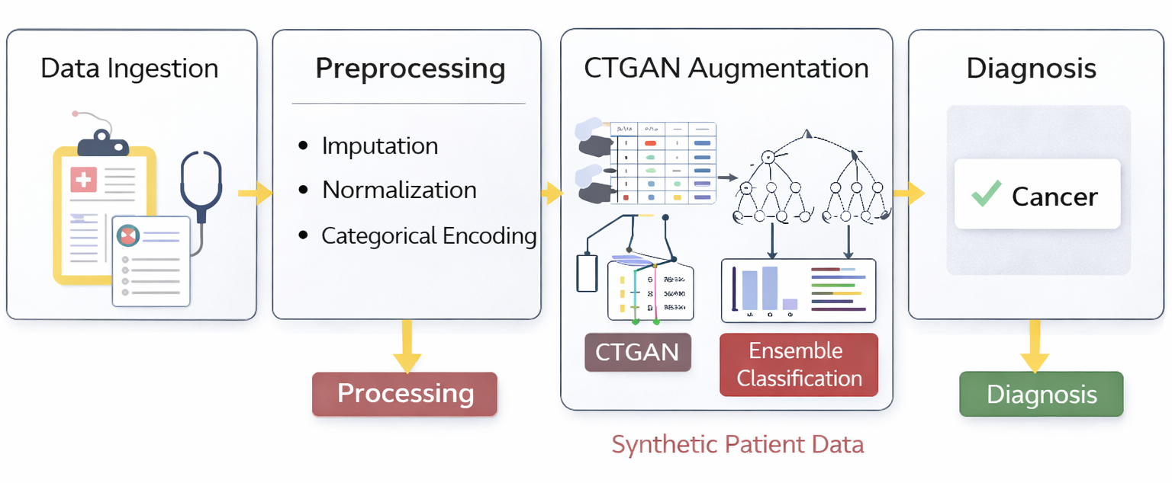
Fig 4 : Implementation Method of Lung Cancer Diagnosis

Slide 18
System Requirements
Hardware Requirements:
Processor: Intel i5 or higher
RAM: Minimum 8 GB (16 GB recommended)
Storage: At least 256 GB
Software Requirements:
Programming Language: Python 3.x
Libraries: Scikit-learn, Pandas, NumPy, CTGAN
Frameworks: Flask (for deployment)
OS: Windows/Linux/Mac

Slide 19
Results
The proposed model combining CTGAN with ensemble learning achieved high performance in lung cancer prediction. The system showed improvements in accuracy, precision, recall, and F1-score compared to traditional models. Data augmentation using CTGAN effectively handled class imbalance, leading to better identification of high-risk patients. The model also demonstrated reliable and consistent performance across multiple test runs.

Slide 20
Conclusion
It focuses on the seamless integration and performance optimization of CTGAN and Random Forest models for early-stage lung cancer detection. By combining Conditional Tabular Generative Adversarial Networks (CTGAN) for realistic synthetic data generation with a Random Forest classifier for robust decision-making, the framework improves data balance, strengthens feature learning, and enhances early detection performance. This plays a vital role in increasing overall survival rates among individuals diagnosed with lung cancer.

Slide 21
References
[1] M. Aharonu and L. Ramasamy, ‘‘A multi-model deep learning framework and algorithms for survival rate prediction of lung cancer subtypes with region of interest using histopathology imagery,’’ IEEE Access, 2024, doi: 10.1109/ACCESS.2024.3484495.
[2] X. Ye, W. Zhang, and T. Sakurai, ‘‘Adaptive unsupervised feature learning for gene signature identification in non-small-cell lung cancer,’’ IEEE Access, vol. 8, pp. 154354–154361, 2020, doi: 10.1109/ACCESS.2020.3018480.
[3] L. Hussain, W. Aziz, A. A. Alshdadi, M. S. A. Nadeem, I. R. Khan, and Q.-U.-A. Chaudhry, ‘‘Analyzing the dynamics of lung cancer imaging data using refined fuzzy entropy methods by extracting different features,’’ IEEE Access, vol. 7, 2019, doi: 10.1109/ACCESS.2019.2917303.
[4] B. Ozdemir, E. Aslan, and I. Pacal, ‘‘Attention enhanced InceptionNeXt-based hybrid deep learning model for lung cancer detection,’’ IEEE Access, vol. 13, pp. 27051–27067, 2025, doi: 10.1109/ACCESS.2025.3539122.
[5] A. Teramoto, H. Fujita, T. Yamada, and H. Kato, ‘‘Deep learning methods for lung cancer segmentation in whole-slide histopathology images—The ACDC@LungHP Challenge 2019,’’ IEEE Access, vol. 7, pp. 115543–115552, 2019, doi: 10.1109/ACCESS.2019.2936414.
[6] A. Teramoto, H. Fujita, T. Yamada, and H. Kato, ‘‘End-to-end fully automated lung cancer screening system,’’ IEEE Trans. Med. Imag., vol. 38, no. 12, pp. 2867–2877, Dec. 2019, doi: 10.1109/TMI.2019.2911339.

Slide 22
[7] S. Doppalapudi, R. G. Qiu, and Y. Badr, “Lung cancer survival period prediction and understanding: Deep learning approaches,” Int. J. Med. Informat., vol. 148, Apr. 2021, Art. no. 104371, doi: 10.1016/j.ijmedinf.2020.104371.
[8] M. Anthimopoulos, S. Christodoulidis, L. Ebner, A. Christe, and S. Mougiakakou, “Lung pattern classification for interstitial lung diseases using a deep convolutional neural network,” IEEE Trans. Med. Imaging, vol. 35, no. 5, pp. 1207–1216, May 2016, doi: 10.1109/TMI.2016.2535865.
[9] W. Zhang, R. Li, H. Deng, L. Wang, W. Lin, S. Ji, and D. Shen, “Deep convolutional neural networks for multi-modality isointense infant brain image segmentation,” NeuroImage, vol. 108, pp. 214–224, Mar. 2015, doi: 10.1016/j.neuroimage.2014.12.061.
[10] N. Tajbakhsh et al., “Convolutional neural networks for medical image analysis: Full training or fine tuning?” IEEE Trans. Med. Imaging, vol. 35, no. 5, pp. 1299–1312, May 2016, doi: 10.1109/TMI.2016.2535302.
[11] K. He, X. Zhang, S. Ren, and J. Sun, “Deep residual learning for image recognition,” in Proc. IEEE Conf. Comput. Vis. Pattern Recognit. (CVPR), Las Vegas, NV, USA, Jun. 2016, pp. 770–778, doi: 10.1109/CVPR.2016.90.

Slide 23
Thank You & any Queries

